Slide 1
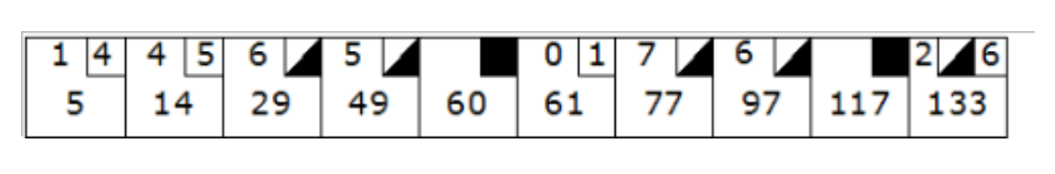
Bowling Exercise
Bowling Game Scoring
FrameRollsCtrl
Frame
Notes:
Foreach Roll(NumOfPins)
Find/get the current frame
Add the number of pins knocked down to that frames FrameRollsCtrl
If any pending score frames exist, add the number of pins knocked down to that pending frame
Score()
If any pending frames are ready to score, score them and remove the pending frame. from the list
If the current frame is Over
If the frame does not need future rolls to score
write its score in the frame.
Else, add that frame number to the Pending list.
If Frame is finished(Over), move pointer to the next frame. If at end, GameOver is true.

